Slide 1









Chef Parteek’s Kitchen
Youtube Channel
Performance
Analysis
Our services will help you provide the best solution so that your business can run smoothly.
SUBSCRIBE

Slide 2
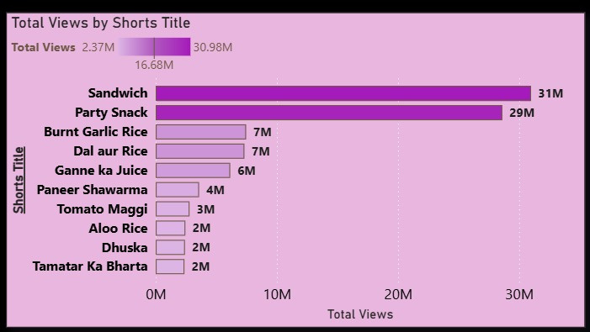
Key Insights Summary :-
Key Insights from Shorst Data
1 . Some shorts reaches 15K+ views, indicating strong topic resonance .
2 . High like -to -views ratios,but low comment activity.
3 . Uses of hashtags - Discoverability is high .
4 . according to outliers - Some shorts are underperfromed .
5 . Posting in evening/weekends drive better results.

Slide 3
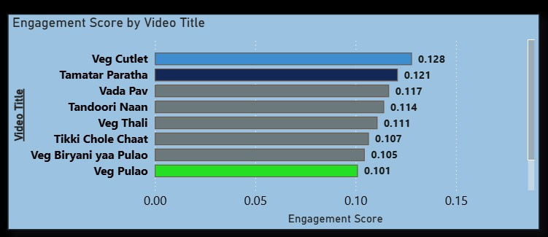
Key Insights from Video Data :-
1 . Stable views (3.5K–5K), strong niche (Indian food recipes).
2 . Positive sentiment in comments (analyzed using TextBlob) .
3 . Consistent audience engagement ~4–5%
4 . Hashtags missing, reducing SEO potentialt
5 . Weak interaction rate (low comments)

Slide 4

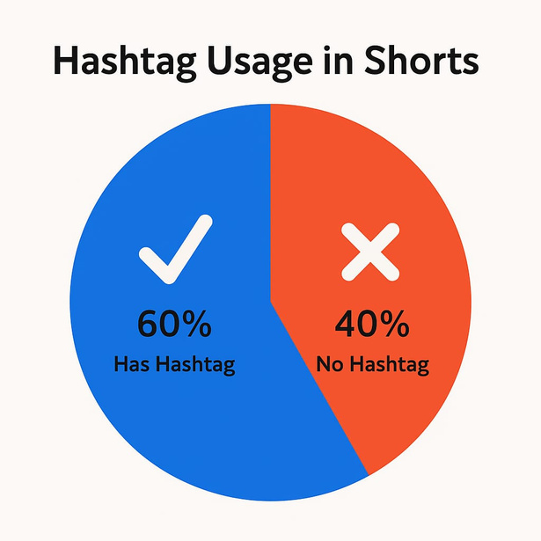
Business Implications
Strategic Implications :-
1 . Missed SEO opportunity = lower reach
2. Low comments = weaker community building.
3 . Positive sentiment = strong brand perception
4 . Consistency in uploads = algorithm favorability

Slide 5


Recommendations
Actionable Recommendations
1 . Add hashtags and trending keywords to Shorts/Videos .
2 .Encourage comments with CTAs (Call to Actions) .
3 .Reuse top Shorts for Instagram Reels .
4 . Collaborate with food influencers to expand reach .
5 . Schedule posts during high-engagement times (evening/weekend) .

Slide 6
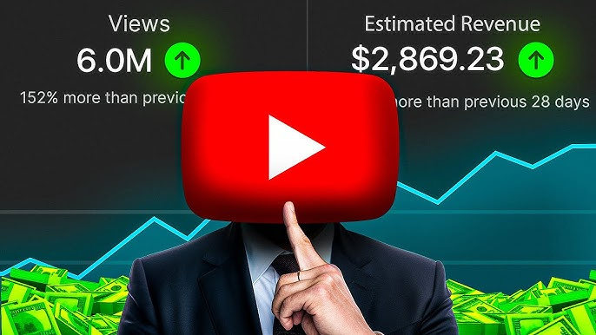
Future Strategy
1. Enhance Engagement Through Content Design .
2. Optimize Posting Schedule .
3. Leverage High-Performing Videos .
4. Improve Comment Engagement .
5. Monitor & Adapt to Algorithm Trends .
6. Cross-Platform Growth .

Slide 7
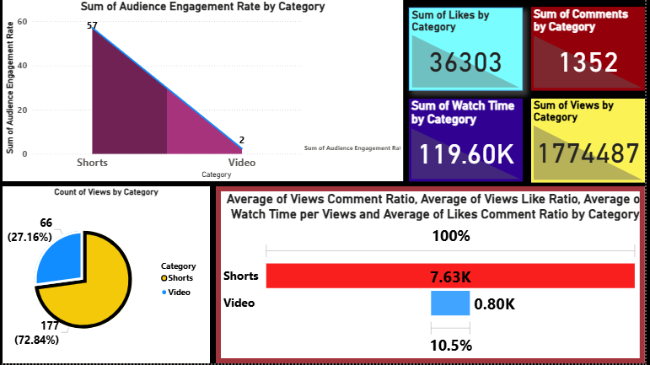
Integrated Performance Comparison
1. Audience Engagement Rate :-
Shorts have high engagement rate by videos . ._
Its highlight that viewers are more intract with shorts as compare to videos .

Slide 8


2. Content Distribution :-
Videos dominate the content library with 177 uploads,while shorts only have 66 uploads .
Still Shorts have the highest Engagement rate as compare to videos .
3. Watch Time & Views :-
Total watch time is 119.6K minutes, heavily driven by videos due to long runtimes .
Total views is 1.77 millons +,which is achieved by both format .

Slide 9
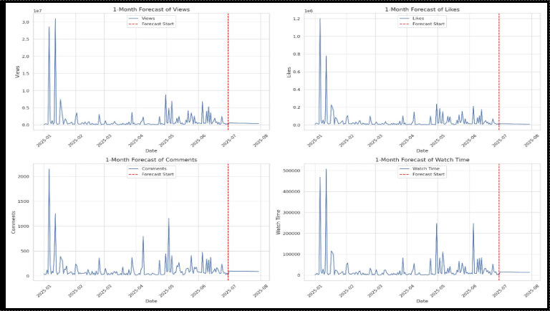
1-Month Forecast for Key YouTube Metrics
This is the One month forecast with the 4 main core that is Views,Likes,Comments and Watch time .
We use historical data and time series modeling .

Slide 10


📈 Views: Forecast indicates a stable trend with slight fluctuations, suggesting consistency in audience reach over the upcoming month.
👍 Likes: The projection shows steady user interaction however, no significant spike is anticipated.
💬 Comments: Engagement through comments remains low and stable, implying minimal community interaction unless action is taken .
⏱️ Watch Time: Shows a plateauing trend, highlighting a potential saturation point in viewer attention span.

Slide 11
Thank You

